Slide 1
Weekly report

Slide 2
Updates from last week
Used gensim.models.Phrases to detect common phrases (multiword expressions) from a stream of sentences.
Created LDA model.
Converted topics to feature vectors using minimum_probability.
Applied machine learning algorithms.
XGB accuracy – 63.6%

Slide 3
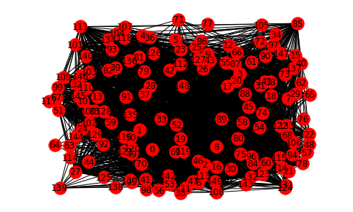

Updates from last week
Calculated Hellinger distance between topics.
It is a metric to measure the difference between two probability distributions.
Created a topic to topic network.

Slide 4
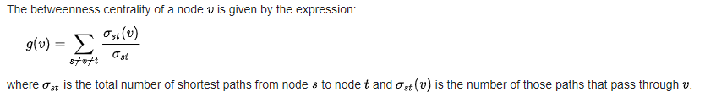
Betweenness centrality
The betweenness centrality is a measure of how many shortest paths pass through a particular vertex. The more shortest paths that pass through the vertex, the more central the vertex is to the network.

Slide 5
Louvain method for community detection in large networks
A heuristic method that is based on modularity optimization.
Find partitions with high modularity.
Follows multilevel hierarchical scheme

Slide 6
algorithm
Different community is assigned to each node of the network.
Phase I
For each node we evaluate the gain of modularity by removing node from its community and by placing it in the community of its neighbour.
The node is then placed in the community for which this gain is maximum
Repeat until no further improvement
Phase 2
A new network is build whose nodes are now the communities found during the first phase.
Weights on links are added.
Repeat until no more changes

Slide 7
